Slide 1

Capstone Project

Slide 2



Personal BACKGROUND
(Name, Past Experience, Qualification, Career Summary)
Name : Harish Kumar Pazhani
Past Experience : Cyber Security Internship at Verzeo: Gained hands-on experience in securing web applications, understanding vulnerabilities, and implementing cybersecurity measures.
Front-End Internship at Global Consultancy Services: Worked on developing responsive and user-friendly web interfaces.
Qualification : B.Tech Information Technology
Career Summary : I am a recent B.Tech IT graduate with experience in cybersecurity and front-end development. Currently, I'm enhancing my skills by learning backend Java and seeking a role that offers growth and learning opportunities.
www.collaberadigital.com

Slide 3


Key Takeaways/Learnings from the Program (HTD)
Java: Developed a strong foundation in object-oriented programming and key concepts like inheritance, polymorphism, and exception handling.
MySQL: Learned to design and manage relational databases, and execute complex queries.
Hibernate: Gained proficiency in ORM for efficient database interactions and mapping Java classes to tables.
Spring & Spring Boot: Built scalable applications using dependency injection, Spring MVC, and RESTful services.
Microservices: Understood and implemented microservices architecture for scalability and modularity.
Docker: Gained experience in containerizing applications for consistent environments across development and production.

Slide 4

Problem Statement of the Capstone Project
The objective is to develop an online shopping cart system that allows customers to add products to their cart, adjust quantities, and place orders directly from the cart. Customers should also have the ability to view and cancel their orders. The primary challenges include accurately tracking and updating product quantities, delivering a seamless user experience from product selection to order placement, and ensuring data integrity and persistence throughout the process.

Slide 5

What is Spring Boot ?
Spring Boot is an extension of the Spring framework that simplifies the setup, configuration, and deployment of Spring applications.
Key Features
Auto-Configuration: Automatically configures your Spring application based on the dependencies you have added.
Embedded Servers: Comes with embedded servers like Tomcat and Jetty to simplify application deployment.
Production-Ready: Includes features like health checks, metrics, and externalized configuration.
Advantages
Rapid Development: Speeds up development with less boilerplate code.
Microservices Support: Easily create and manage microservices-based architecture.
Integration: Seamlessly integrates with other Spring projects like Spring Security, Spring Data, etc.

Slide 6
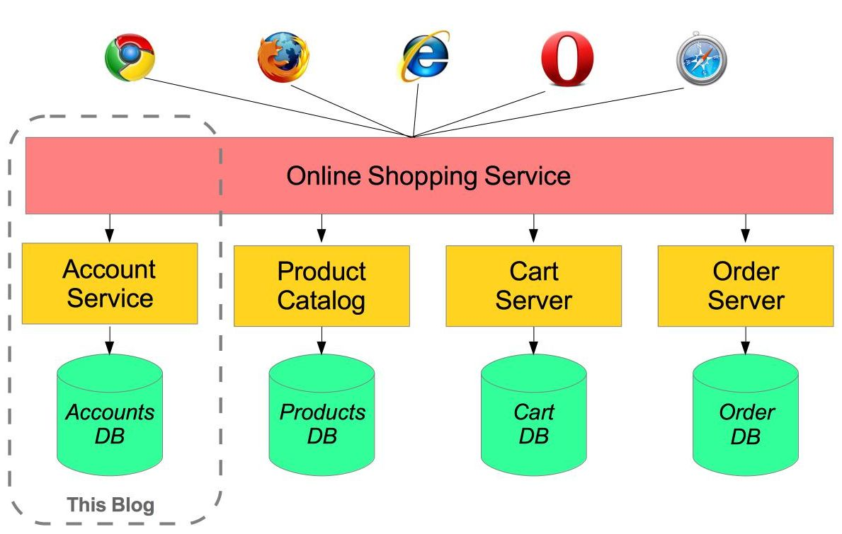
wh
What are Microservices ?
Microservices are an architectural style that structures an application as a collection of loosely coupled, independently deployable services.
Key Features
Scalability: Services can be scaled independently.
Resilience: Failure in one service doesn’t affect others.
Flexibility: Technology stacks can be chosen independently for each service.

Slide 7

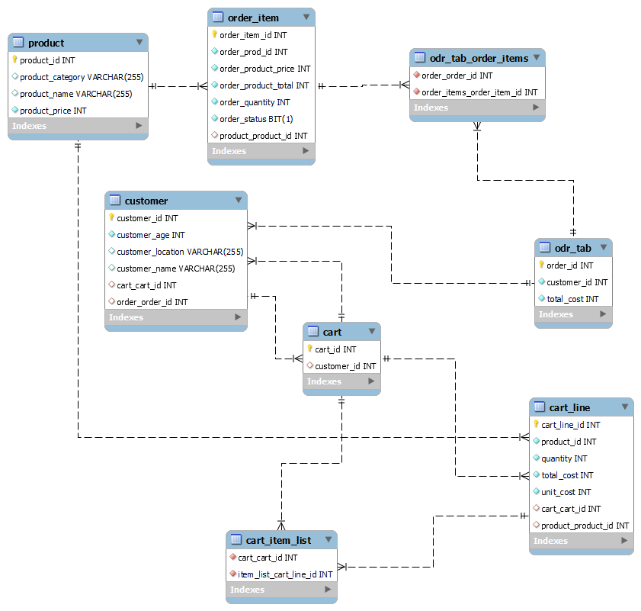

Slide 8

Project Architecture
Controller Layer: Exposes REST endpoints for the client to interact with the application.
Service Layer: Contains the business logic, responsible for processing data between the controller and repository layers.
Repository Layer: Manages database interactions using JPA/Hibernate.
Entity Layer: Maps database tables to Java classes.
Data Flow
Customer interacts with the system via the controller.
Controller forwards requests to the service layer.
Service layer processes requests and interacts with the repository for data retrieval or persistence.
The repository interacts with the database and returns data to the service layer, which then returns the processed data to the controller.

Slide 9
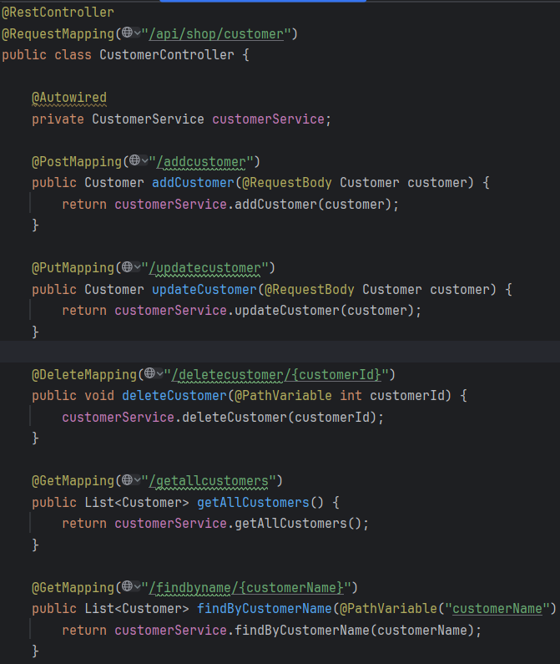
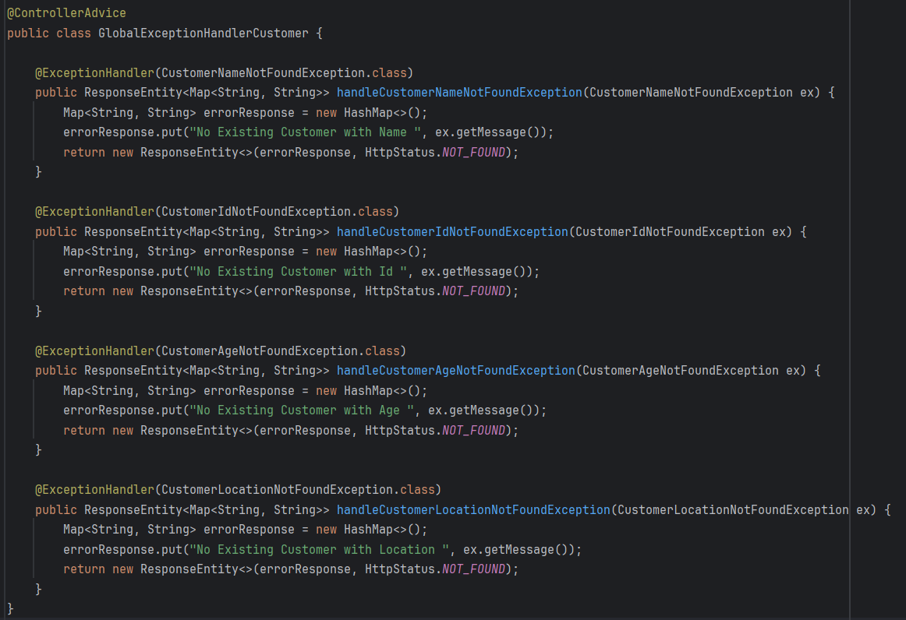
Important areas of the Project with screenshots

Slide 10
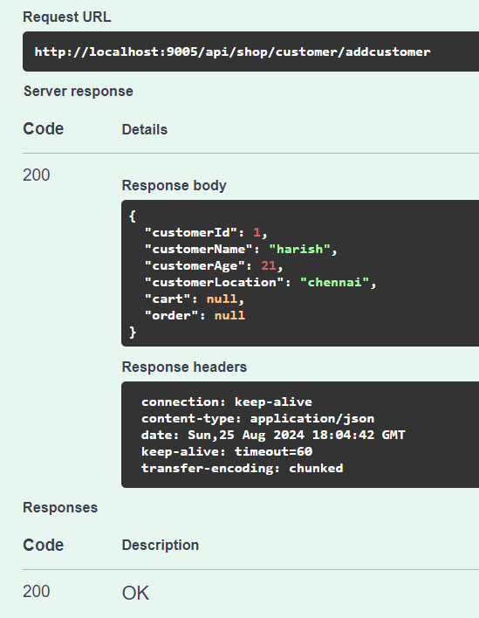
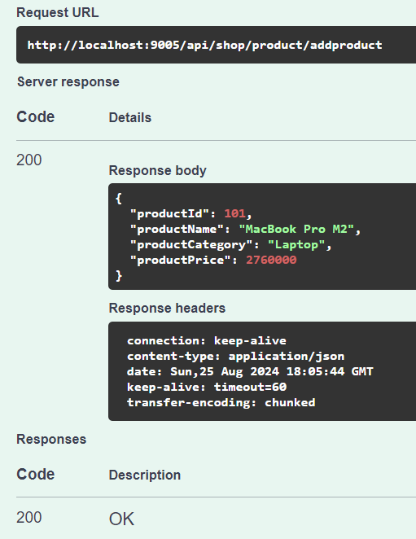
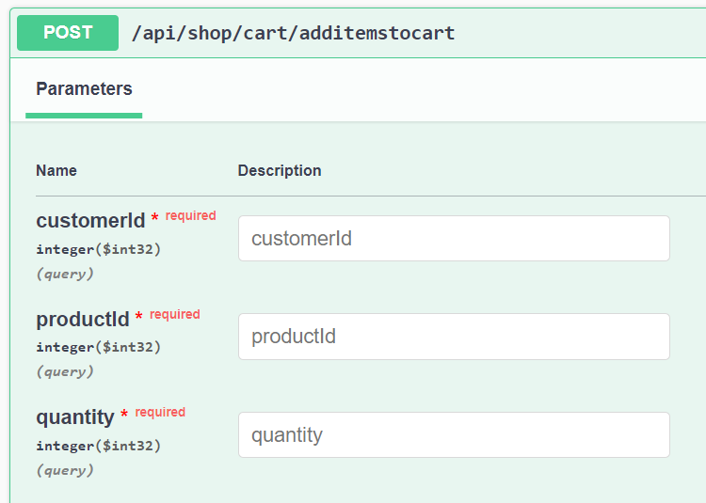
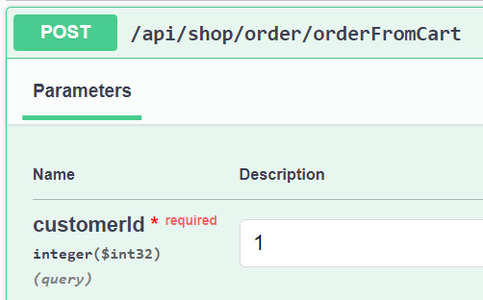
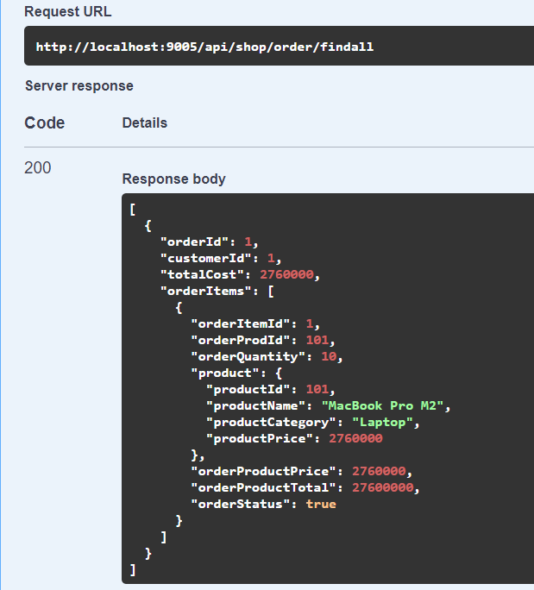
Important areas of the Project with screenshots

Slide 11
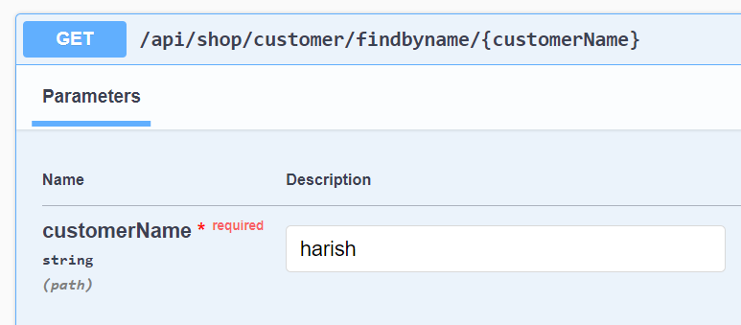
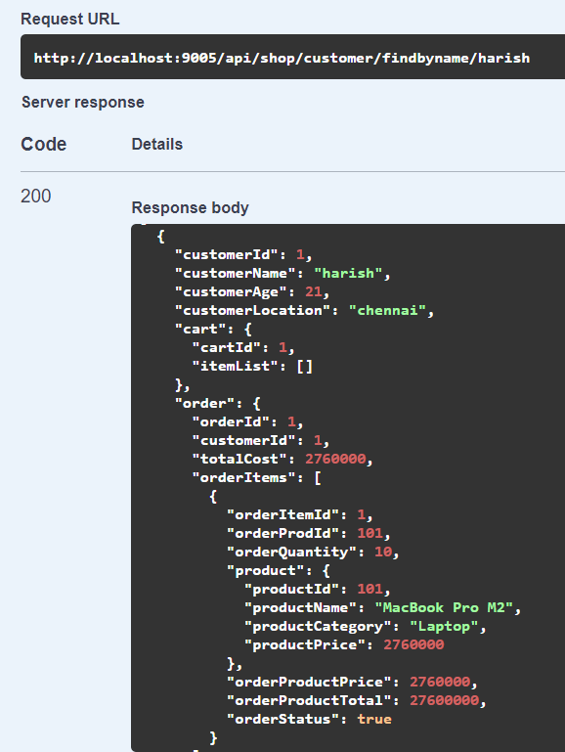
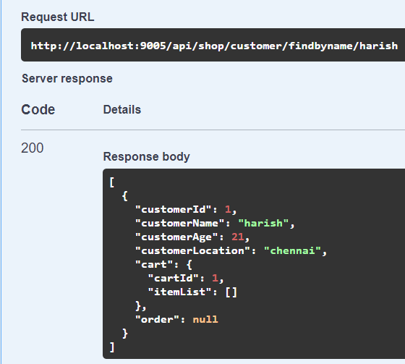
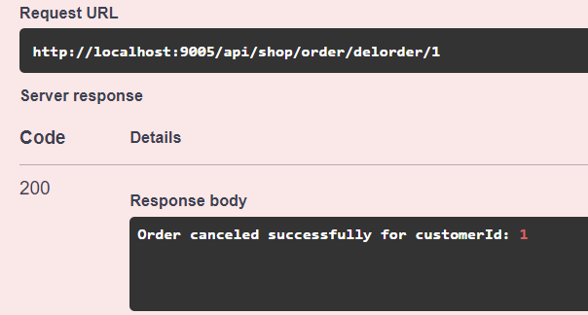
Important areas of the Project with screenshots

Slide 12
Conclusion
The project highlights the development of an online shopping cart system using a monolithic architecture with Spring Boot.
Key Achievements:
Successfully implemented a cohesive and maintainable monolithic architecture.
Gained hands-on experience in building and deploying a robust application using Spring Boot.
Developed effective solutions for handling complex business logic within a unified codebase.
Future Work: Potential enhancements include integrating payment gateways, improving security measures, and optimizing the application for better performance and scalability.---This conclusion reflects your actual work with the monolithic architecture and Spring Boot, giving a clear and accurate wrap-up for your project.

Slide 13
Thank You

